Slide 1
Online Examination System

Slide 2
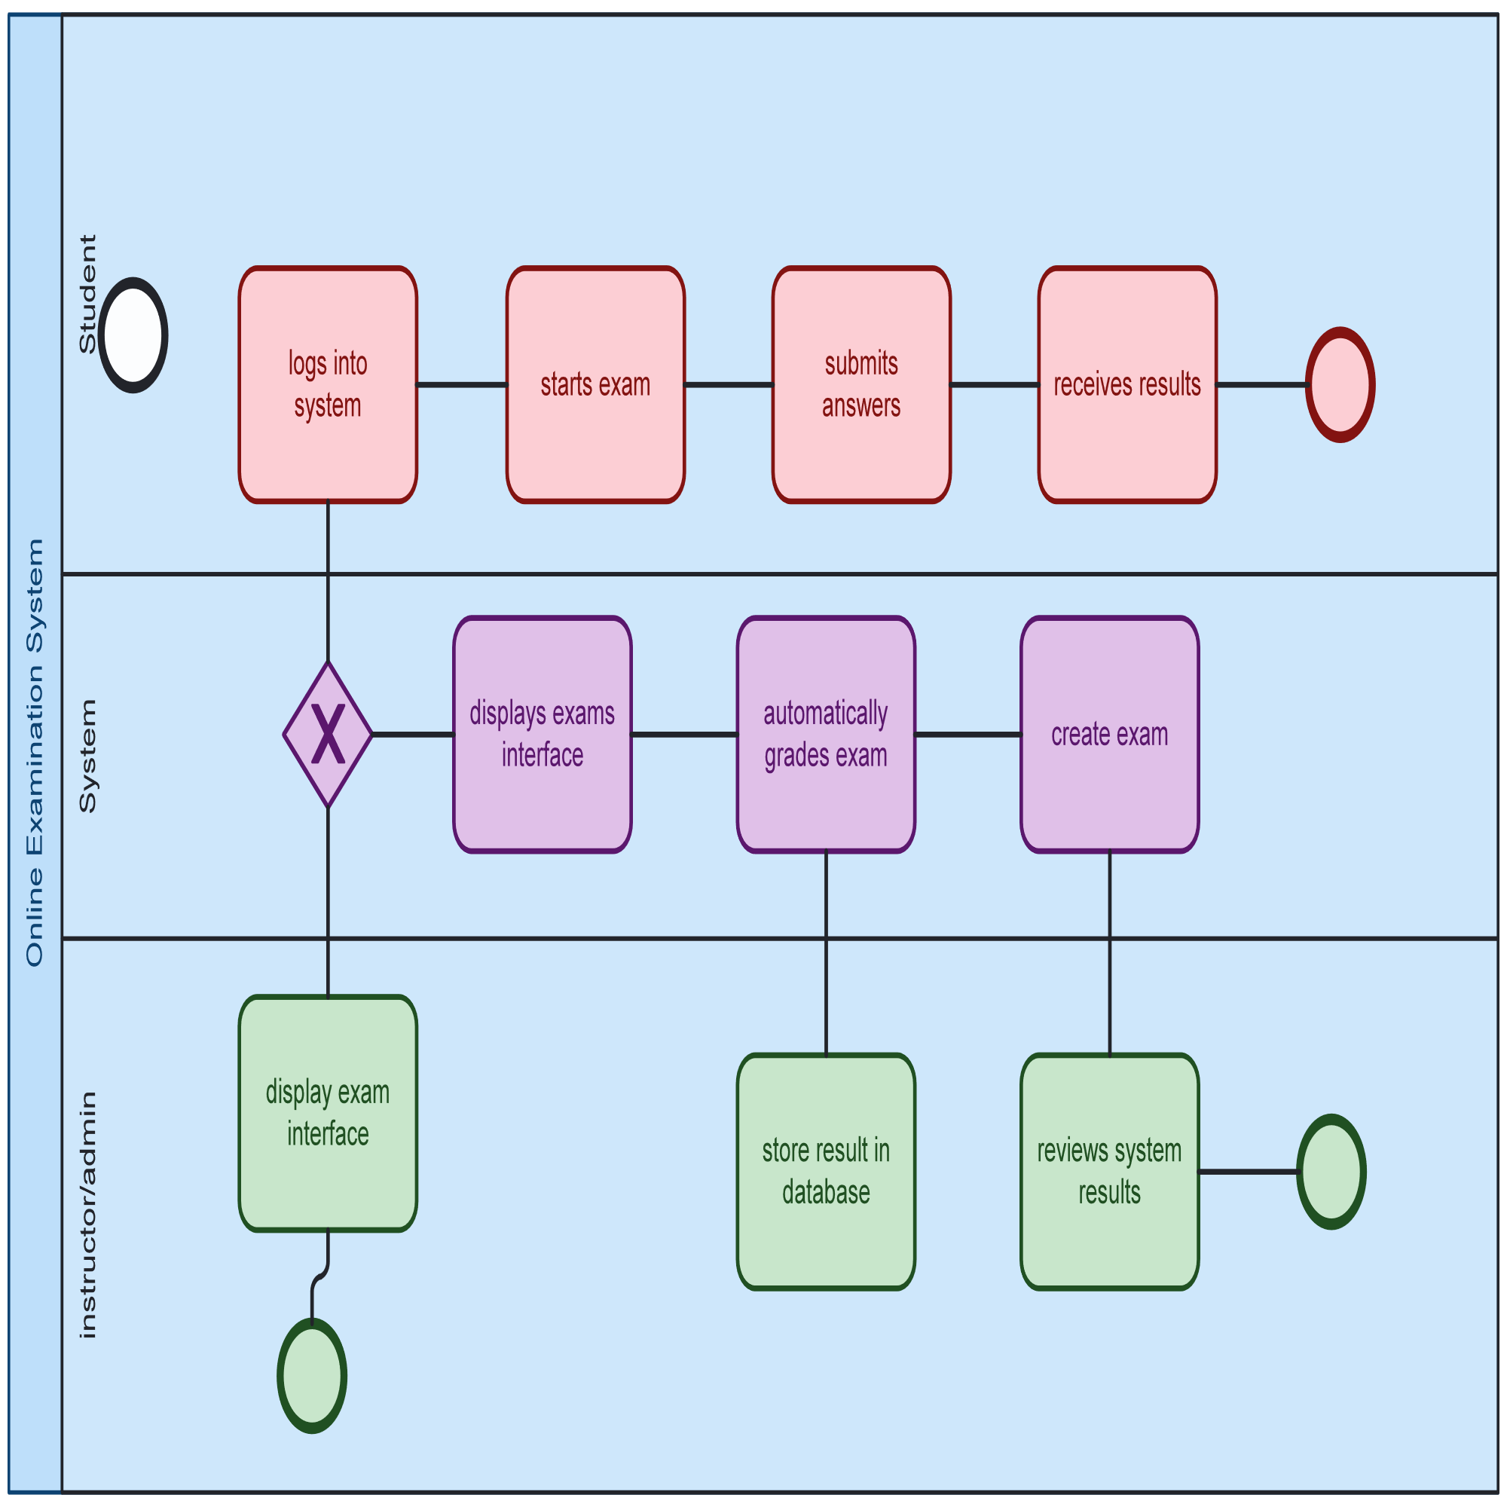
Online Examination System

Slide 3
1. POOLS AND LANES
Pools represent major participants. In this diagram, we have:
Student
System
Instructor/Admin
Each pool contains lanes to separate specific tasks or roles.

Slide 4
2. Student Lane
Login to System: Student logs into the exam platform.
View Available Exams: Browses exams.
Start Exam: Selects and begins the exam.
Answer Questions: Completes the exam.
Submit Exam: Sends answers for grading.
Receive Results: Gets graded outcome.

Slide 5
3. System Lane
Authenticate User: Verifies login credentials.
Display Exam Interface: Loads exam UI.
Record Answers: Saves responses in real time.
Auto-grade Exam: System grades the exam.
Store Results in DB: Saves final scores.
Send Results to Student: Notifies student of their results.

Slide 6
4. Instructor/Admin Lane
Create Exam: Prepares questions and format.
Set Exam Schedule: Assigns date and time.
Monitor Exam (optional): May involve proctoring.
Performance: Reviews student performance.
Provide Feedback: Sends feedback or adjusts exams.

Slide 7
5. Connectors and Events
Sequence Flows: Arrows showing process order.
Message Flows: Dashed lines indicating communication.
Start Event: Triggered when a student logs in.
End Event: Happens after results are delivered.
Gateway (if used): Decision points (e.g., login success).

Slide 8
6. Diagram Purpose
This BPMN provides a clear visualization of how the online examination process flows between users and system components. It helps in understanding, optimizing, and automating the examination lifecycle.

